Slide 1
2019 kidney Transplant Taichung Summit
Time：3/17 (Sunday) Meeting 9:30 ~ 12:30
Venue：Taichung Veterans General Hospital 5th Meeting Room
Time | Topic | Speaker | Moderator
09:30-09:40 | Opening | Dr. Wayne Huey- Herng Sheu 許惠恒院長 The superintendent of Taichung Veterans General Hospital
09:40-10:30 | Post- kidney transplantation complications in long-term: Diabetes, Obesity and CVD | Professor Steven Chadban Royal Prince Alfred Hospital, Sydney | Dr. Wayne Huey- Herng Sheu 許惠恒院長 Taichung Veterans General Hospital
10:30-11:20 | Highly sensitized kidney transplantation: ABO incompatible and Donor-specific anti-HLA antibody | Professor Hideki Ishida Tokyo Women’s Medical University | Dr. Ming-Ju Wu 吳明儒部長 Taichung Veterans General Hospital
11:20-11:40 | Panel Discussion | Professor Hideki Ishida Professor Steven Chadban
11:40-12:00 | Long-Term outcome of BK associated infection at central Taiwan : Experience at Taichung veterans general hospital | Dr.TM Yu 游棟閔醫師 Taichung Veterans General Hospital | Dr. JD Lian 連榮達院長 Chung Shan Medical University Hospital
12:00- 12:20 | Panel Discussion | Dr. Ming-Ju Wu, Dr. JD Lian 吳明儒部長, 連榮達院長
12:20- 12:30 | Closing | Dr. Ming-Ju Wu 吳明儒部長 Taichung Veterans General Hospital

Slide 2
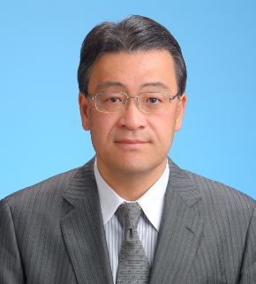
Professor Hideki Ishida
Professor of Department of Organ Transplant Medicine & Urology
Tokyo Women’s Medical University, Japan
Professor Hideki Ishida is currently the professor in the Department of Organ Transplant Medicine & Urology at Tokyo Women’s Medical University.
Prof. Ishida received his medical training at the Hokkaido University, and then he underwent his urology and surgery residency and doctorate programs at the Tokyo Women's Medical University. Previously, he was also an Honorary Clinical Fellow in Transplant Surgery at the University of Cambridge in the United Kingdom, under Prof. Sir Roy Caine.
Prof. Ishida is an active member of medical societies, as he is a Councillor of the Japanese Society for Transplantation, as well as a member of the Japan Surgical Society, the Japanese Society for Urology, the American Society of Transplantation, and the International Transplant Society.

Slide 3
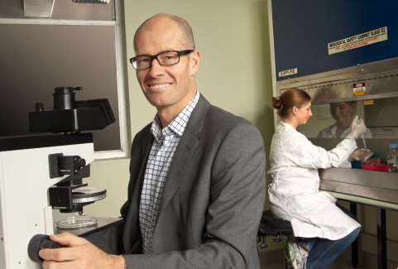
Professor Steven Chadban, PhD, FRACP
Director of Renal Medicine, State-wide Renal Services Royal Prince Alfred Hospital, Sydney, Australia Professor of Medicine, Kidney Hub-CPC, University of Sydney, Australia
Professor Steve Chadban received the University Medal for Medicine at the University of Newcastle, completed physician training in Newcastle, Nephrology training and a PhD at Monash, Victoria, Australia. Following his PhD, Chadban took a post-doctoral position studying immunology at the University of Cambridge, UK.
He returned to Monash University to run the Transplantation Program from 1999–2002 before moving to the Royal Prince Alfred Hospital, Sydney, Australia, where he is Area Director of Renal Medicine, Senior Staff Nephrologist, Professor of Medicine (Nephrology) and Leader of the Kidney Node, Charles Perkins Centre, University of Sydney.
Research interests include CKD and ESKD epidemiology, the molecular mechanisms of transplant rejection and CKD, with a focus on innate immunity, and improving outcomes for kidney transplant recipients through clinical trials. He is a member of TRANSFORM Scientific Committee and one of the study world leaders.
Professor Steve Chadban was the president, Transplantation Society of Australia and New Zealand and has spoken at numerous national and international meetings and has produced over 200 papers published in journals including the New England Journal of Medicine, JAMA, Lancet and the Journal of Clinical Investigation.

